Slide 1



SOFTWARE DEVELOPMENT PROFESSIONAL PROGRAM
JavaScript Review

Slide 2





JavaScript Review
Learning Objectives
Review function syntax.
Review ternary operators.
Review the .map() array method.

Slide 3

JavaScript Review
Preparation for JSX
JSX
Stands for JavaScript XML
Allows you to write a mishmash of JavaScript and HTML
The new syntax makes it easier to build dynamic webpages based on data.
There are a few gotchas! with this new syntax.
We will review some key JavaScript concepts and syntaxes.

Slide 4
JavaScript Review
Function Syntax
There are many ways to write a function in JavaScript.
As you research and learn more about JavaScript, you will continue to see a variety of syntaxes being used.
Let's review some of the most common ones and their nuances.
Notes:
Since learners often struggle with syntax, focus this review more on syntax and less on the other nuances/concepts.
There will be future opportunities to go more in depth, where more practical/real-world examples will be better
at demonstrating the whys.

Slide 5


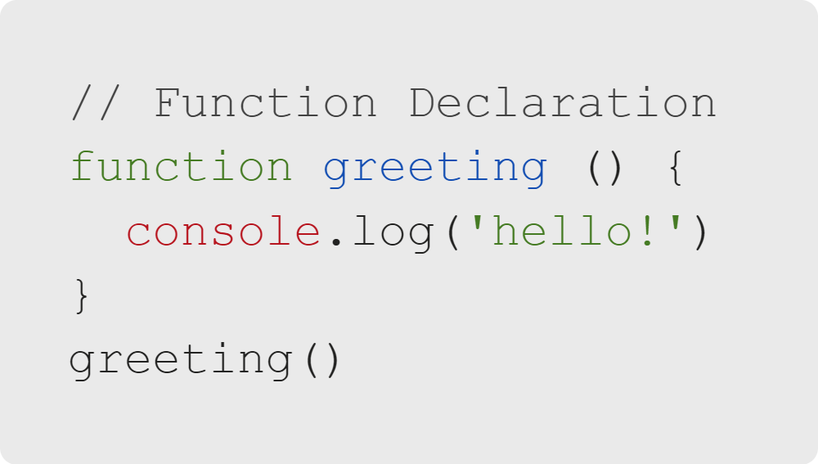
JavaScript Review
Function Declaration
There are two ways to create functions using the keyword function.

Slide 6
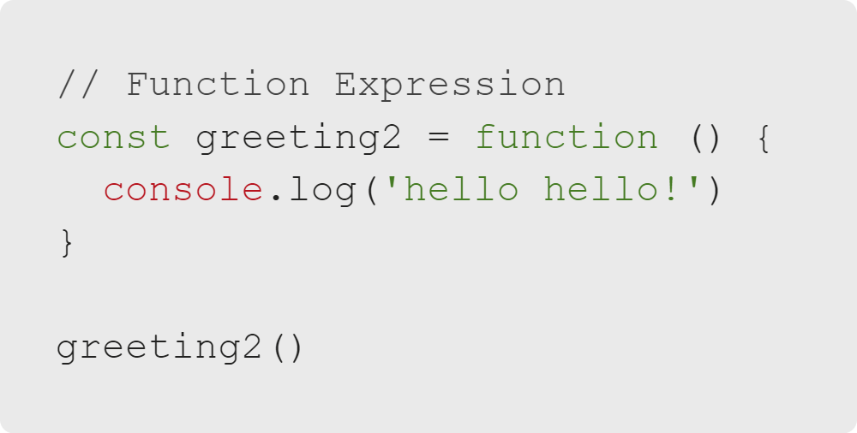
JavaScript Review
Function Expression
There are two ways to create functions using the keyword function.

Slide 7
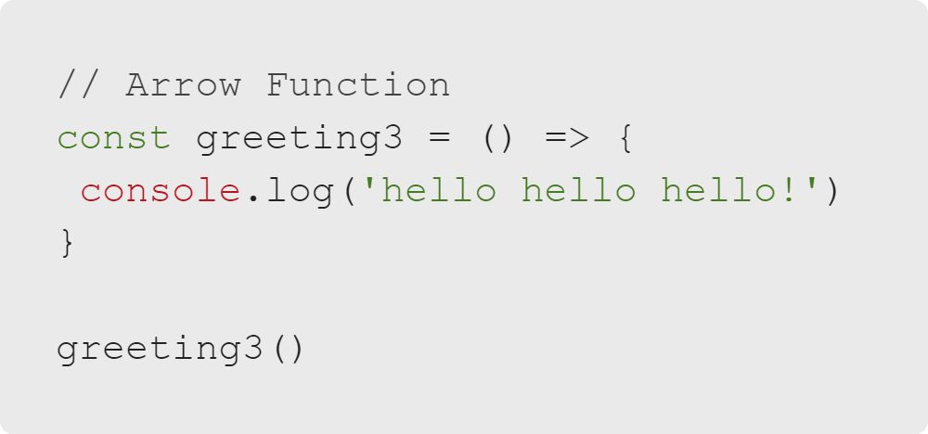
JavaScript Review
Arrow Function: Classic
Arrow functions have many syntax variations.
They can only be written as function expressions.
Notes:
This is also a function expression.

Slide 8
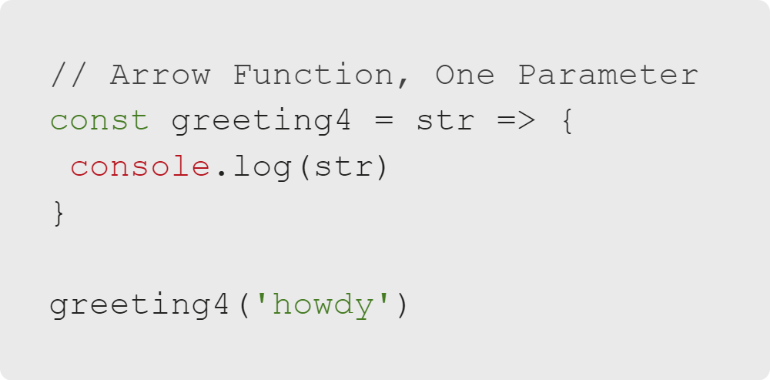
JavaScript Review
Arrow Variation: One Argument
If there is one parameter, you can drop the parentheses.
Notes:
This is also a function expression.

Slide 9
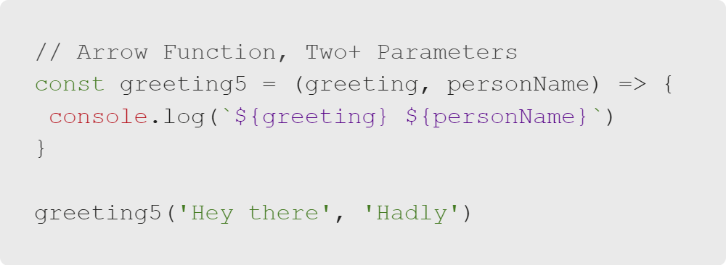
JavaScript Review
Arrow Variation: Two Arguments
If you have two or more parameters, you must use parentheses.
Note: You must also use parentheses if there are no parameters.

Slide 10
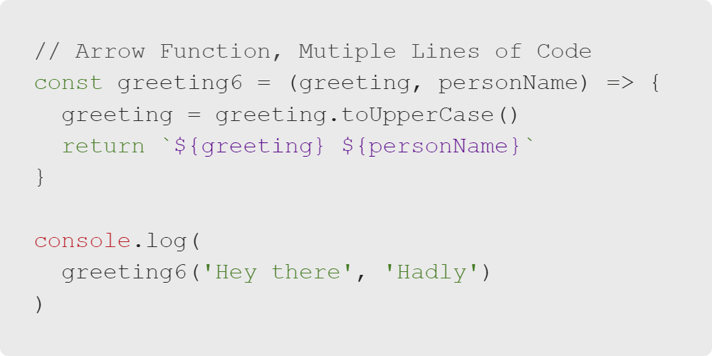
JavaScript Review
Arrow Variation: Multiple Lines of Code
We have changed the location of console.log to demonstrate returning values.

Slide 11
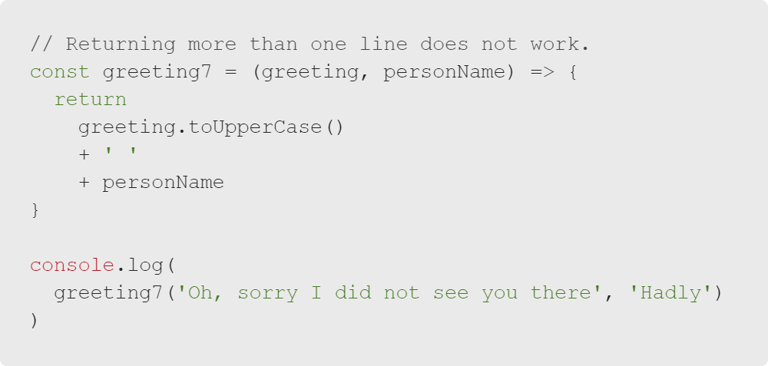
JavaScript Review
Return Statement Review
Return statements can only return one thing (number, string, array, object, etc.) or one line of code.
Notes:
Ask learners if they think this code would work and why.

Slide 12
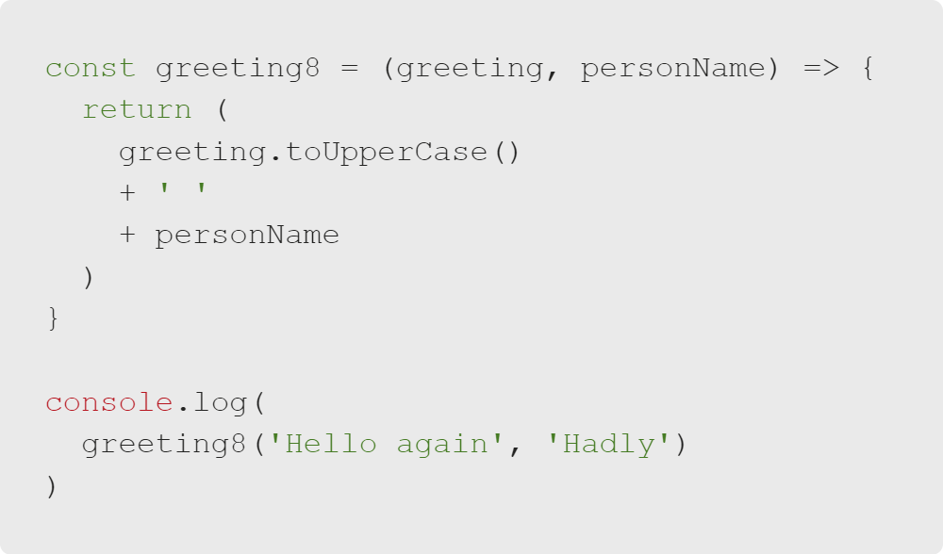
JavaScript Review
Return Statement: Single Lines of Longer Code
If one line of code is verbose or long, you can wrap it in parentheses()to make it more readable.

Slide 13
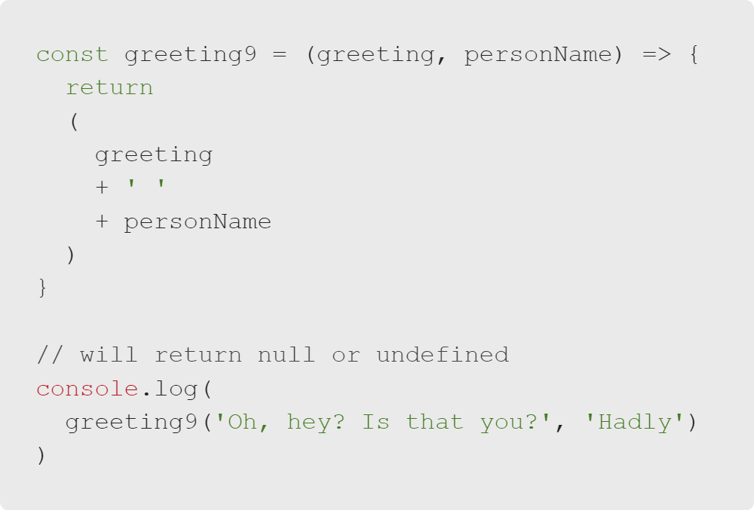
JavaScript Review
Return Syntax Gotcha
You must start the parentheses on the same line as the return or the value returned will be null.

Slide 14
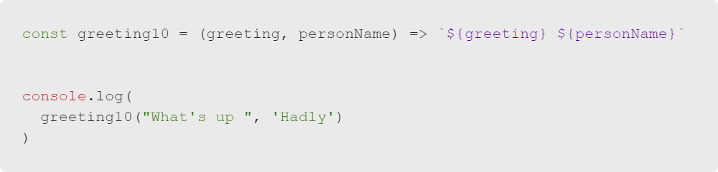
JavaScript Review
Arrow Function Shortened
If the code for the arrow function is only one line, you can drop the parentheses. When there are no parentheses, you do not need a return statement. The return is implied.

Slide 15
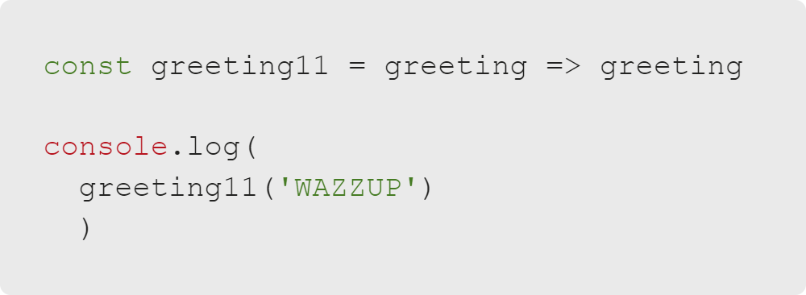
JavaScript Review
Arrow Variation: Can Look Quite Different
This can make arrow functions look very odd compared to what you are used to seeing, especially when you have just one parameter.

Slide 16
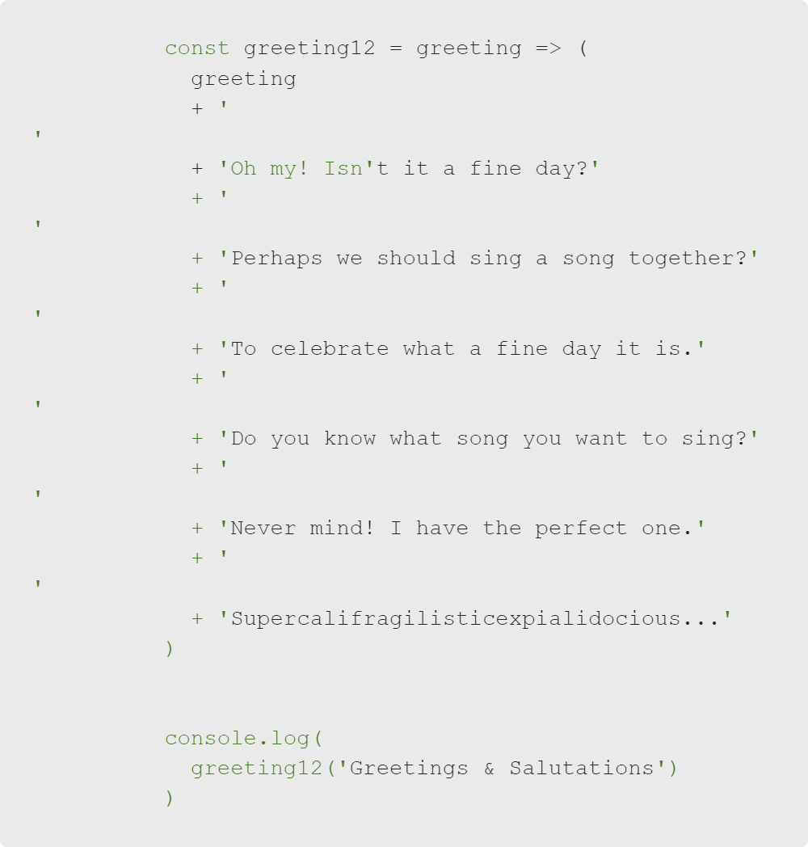
JavaScript Review
Arrow Variation: One Really Long Line
Again, you can follow the same convention for one line. You do this because it is easier to read longer, single lines of code.

Slide 17
JavaScript Review
Good-bye "for" Loops and "if" Statements
Some of the most reliable JS tools will be unavailable when writing JSX.
Unavailable Syntax | Replacement
for loops | .map()
if statements | ternary operators

Slide 18
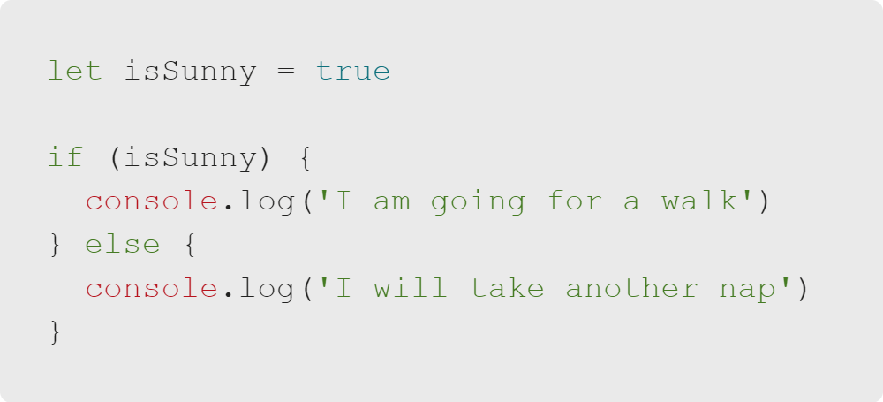
JavaScript Review
Ternary Operator Review
Because you will not be able to use if statements, you must use alternative syntax.

Slide 19
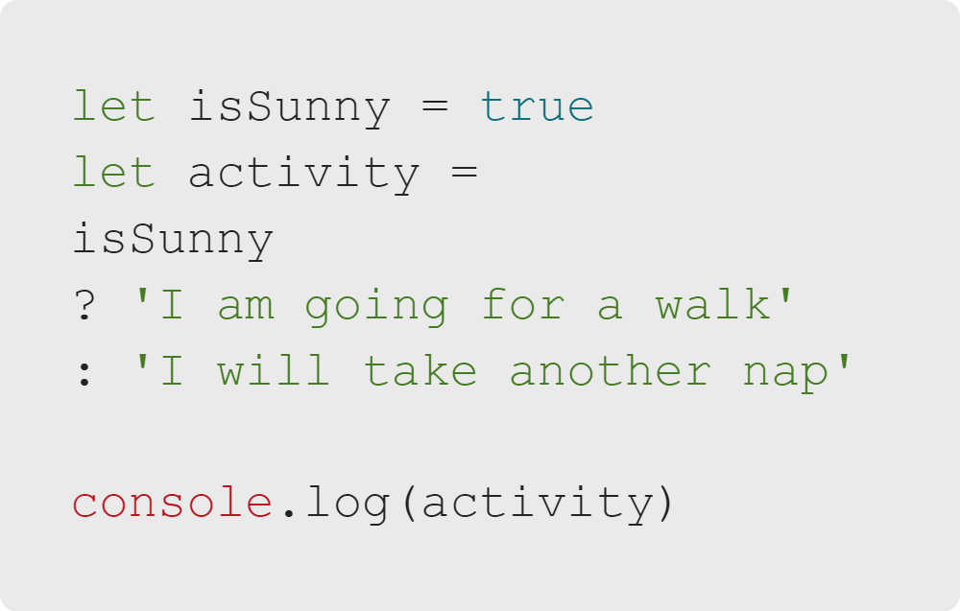
JavaScript Review
Ternary Operator Review
In the simplest terms, ternary operators are a shortcut syntax for if/else statements.

Slide 20
JavaScript Review
Ternary Operator Review
Put together a ternary operator:
What you want to evaluate
?
If true, then do this
:
Else, do this

Slide 21
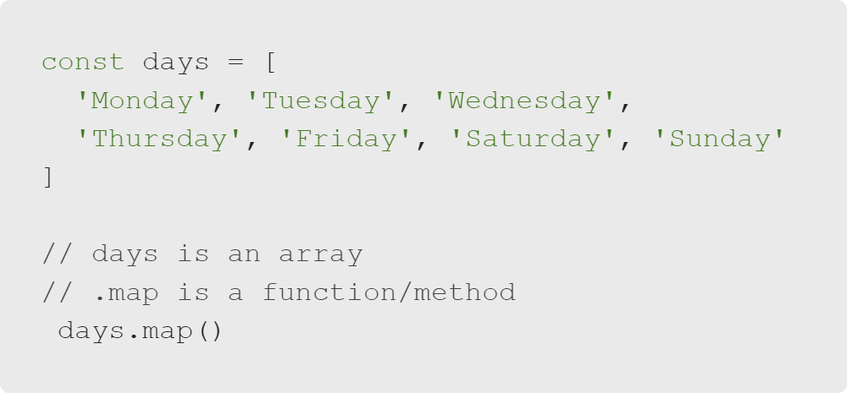
JavaScript Review
.map() Review
.map() is an array method that returns a new array. It takes a callback as a parameter.

Slide 22
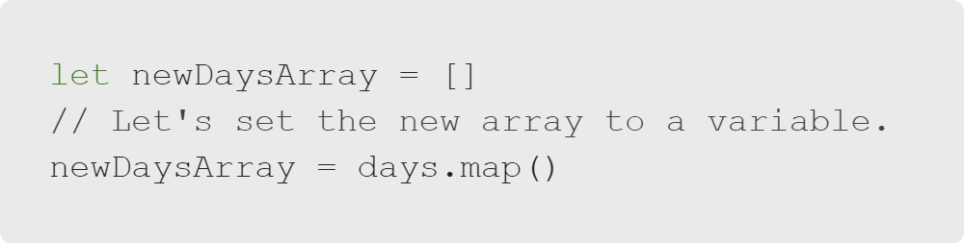
JavaScript Review
Using .map()
Set a new variable to store the new array.

Slide 23
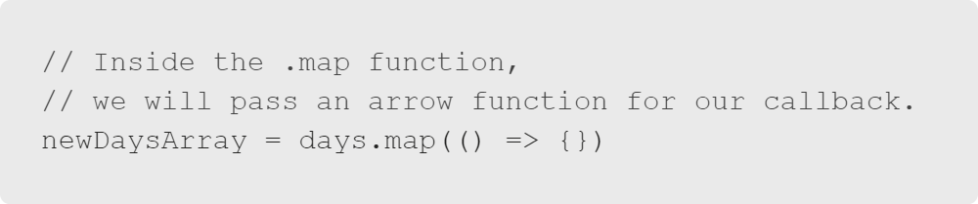
JavaScript Review
Using .map(): Set up a Callback
.map() takes a callback as the first parameter.

Slide 24
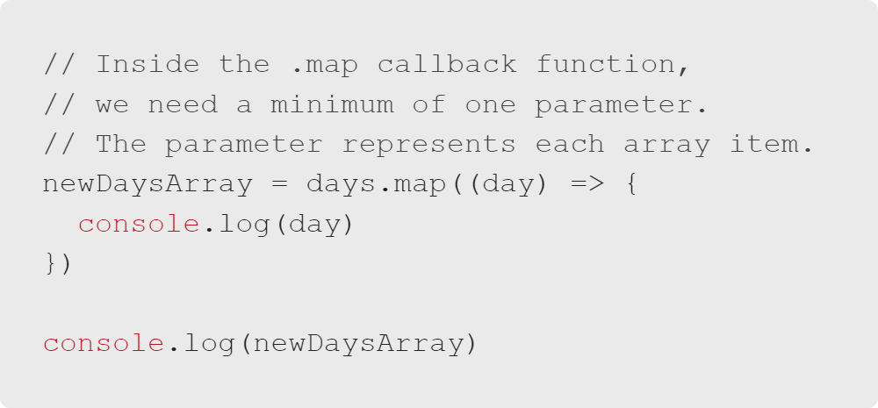
JavaScript Review
Pass Parameter to Callback
.map() takes a callback as the first parameter.
Notes:
The newDaysArray will return with all undefined values.

Slide 25
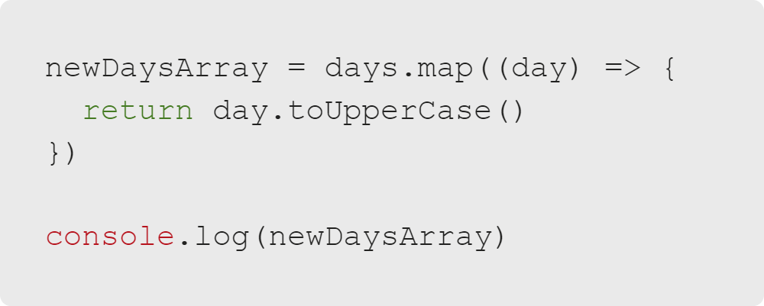
JavaScript Review
Return a Value in the Callback
You must return a value in the callback.
Notes:
Success! This should now return a new array with each day in all caps.

Slide 26
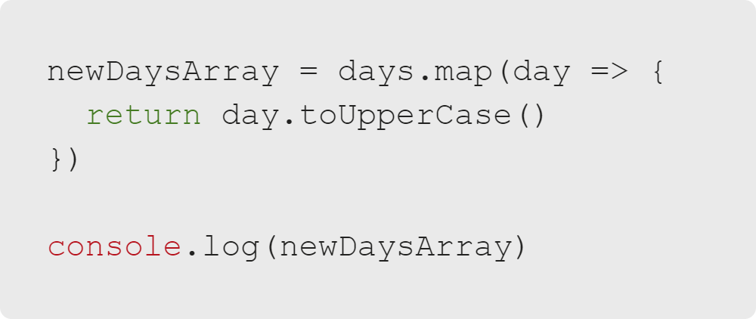
JavaScript Review
Shorten the Code
Get rid of the parentheses around the parameter.
Notes:
Success! This should now return a new array with each day in all caps.

Slide 27
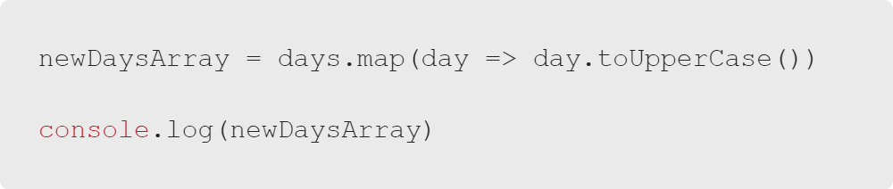
JavaScript Review
Shorten the Code More
Remember, you don't need a return when you are returning one line without curly braces.
Notes:
Success! This should now return a new array with each day in all caps.

Slide 28
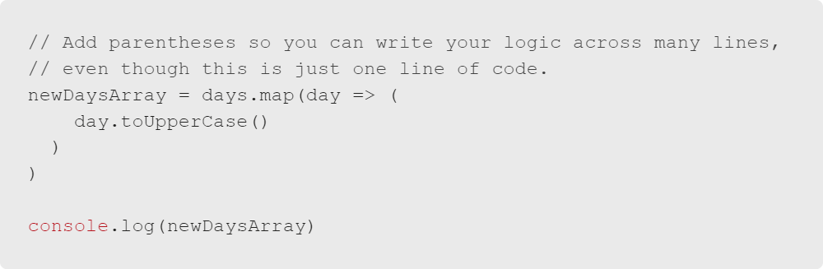
JavaScript Review
Add a Ternary Operator
We want to add a ternary operator. To make it easier to read, let's add parentheses, so we can stretch it across multiple lines.
Notes:
Success! This should now return a new array with each day in all caps.

Slide 29
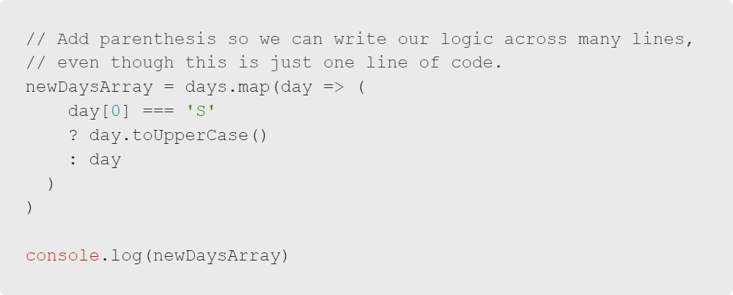
JavaScript Review
Add Some Logic
Let's make the function only capitalize the day if it starts with S.
Notes:
Success! This should now return a new array with only Saturday and Sunday in all caps.

